Slide 1
HARD PROBLEMS
The Story of things we don’t know how to do
Notes:
note

Slide 2
What is a problem?
Notes:
Easy things. Specifically, easy COMPUTATIONAL PROBLEMS.
What’s a computational problem?
Any time you can list the steps to a problem, it can be a computational problem. The list of steps is an algorithm.

Slide 3
What is a problem?
A computational problem is a problem that can be solved using a computer.
Notes:
Easy things. Specifically, easy COMPUTATIONAL PROBLEMS.
What’s a computational problem?
Any time you can list the steps to a problem, it can be a computational problem. The list of steps is an algorithm.

Slide 4
What is a problem?
A computational problem is a problem that can be solved using a computer.
We use algorithms to solve problems with computers.
Notes:
Easy things. Specifically, easy COMPUTATIONAL PROBLEMS.
What’s a computational problem?
Any time you can list the steps to a problem, it can be a computational problem. The list of steps is an algorithm.

Slide 5
What is a problem?
A computational problem is a problem that can be solved using a computer.
We use algorithms to solve problems with computers.
Example:
“Find all the prime factors of n”
Notes:
Easy things. Specifically, easy COMPUTATIONAL PROBLEMS.
What’s a computational problem?
Any time you can list the steps to a problem, it can be a computational problem. The list of steps is an algorithm.

Slide 6
What is a problem?
A computational problem is a problem that can be solved using a computer.
We use algorithms to solve problems with computers.
Example:
“Check if p is a factor of n”
Notes:
Easy things. Specifically, easy COMPUTATIONAL PROBLEMS.
What’s a computational problem?
Any time you can list the steps to a problem, it can be a computational problem. The list of steps is an algorithm.

Slide 7

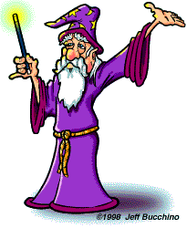


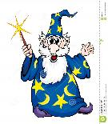
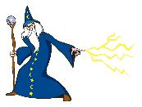

What is a problem?
A computational problem is a problem that can be solved using a computer.
We use algorithms to solve problems with computers.
Example:
“Find the largest group of wizards who are all wearing the same color of battle robes”
Notes:
Easy things. Specifically, easy COMPUTATIONAL PROBLEMS.
What’s a computational problem?
Any time you can list the steps to a problem, it can be a computational problem. The list of steps is an algorithm.

Slide 8
What is a HARD problem?
We will measure how hard a problem is by how long it takes (a computer) to find the answer
Computers run at different speeds, so we really want to know how many steps the algorithm takes.
So: A hard problem is one that is very slow to solve, and an easy problem is one that is fast to solve on a computer.
Notes:
Easy things. Specifically, easy COMPUTATIONAL PROBLEMS.
What’s a computational problem?
Any time you can list the steps to a problem, it can be a computational problem. The list of steps is an algorithm.

Slide 9
What is a HARD problem?
We will measure how hard a problem is by how long it takes (a computer) to find the answer
Computers run at different speeds, so we really want to know how many steps the algorithm takes.
So: A hard problem is one that is very slow to solve, and an easy problem is one that is fast to solve on a computer.
Notes:
Easy things. Specifically, easy COMPUTATIONAL PROBLEMS.
What’s a computational problem?
Any time you can list the steps to a problem, it can be a computational problem. The list of steps is an algorithm.

Slide 10
What is a HARD problem?
We will measure how hard a problem is by how long it takes (a computer) to find the answer
Computers run at different speeds, so we really want to know how many steps the algorithm takes.
So: A hard problem is one that is very slow to solve, and an easy problem is one that is fast to solve on a computer.
Notes:
Easy things. Specifically, easy COMPUTATIONAL PROBLEMS.
What’s a computational problem?
Any time you can list the steps to a problem, it can be a computational problem. The list of steps is an algorithm.

Slide 11
What is a HARD problem?
We will measure how hard a problem is by how long it takes (a computer) to find the answer
Computers run at different speeds, so we really want to know how many steps the algorithm takes.
So: A hard problem is one that is very slow to solve, and an easy problem is one that is fast to solve on a computer.
But how can we measure exactly how hard a problem is?
Notes:
Easy things. Specifically, easy COMPUTATIONAL PROBLEMS.
What’s a computational problem?
Any time you can list the steps to a problem, it can be a computational problem. The list of steps is an algorithm.

Slide 12
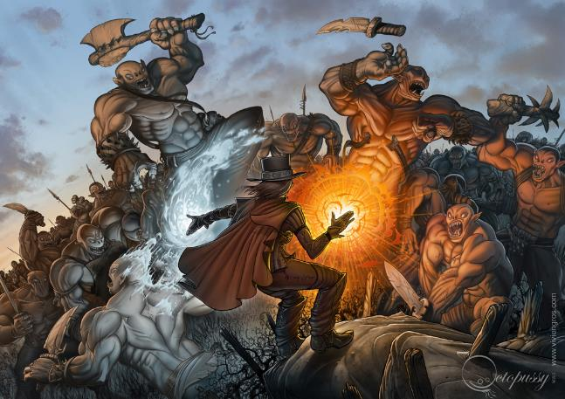
In the beginning…
Notes:
2 wizard factions at war over the correct pronunciation of the word “gif”. They only have a limited amount of time in battle to cast spells so they need to learn to be efficient to win.
Things Smelling Like Fish. You cast it once for each enemy in the battle and they smell rotting fish for the next half an hour. One step for each enemy, so it is a O(N) spell. Scales linearly.
the spell of Pairwise Protection requires you to cast it on each pair of friends and enemies. If there are N enemies and M friends, you need to cast it M*N times. So the cost is O(M*N).
The spell of broken command chain is O(n!)

Slide 13
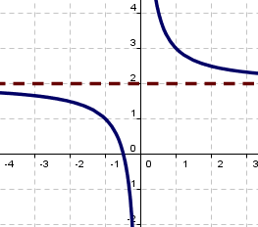
How Fast are your Functions?
“Asymptotics”
=
Behavior as the function
goes to infinity

Slide 14
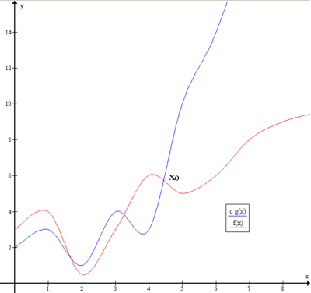
How Fast are your Functions?

Slide 15
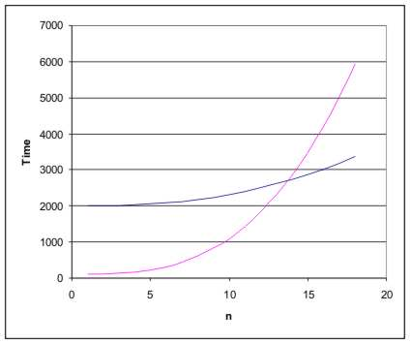
How Fast are your Functions?

Slide 16
Big-O Notation
Big O notation is a way we can measure how long an algorithm takes to run.

Slide 17
Big-O Notation
Big O notation is a way we can measure how long an algorithm takes to run.
It's how we compare the efficiency of different approaches to a problem.

Slide 18
Big-O Notation
Big O notation is a way we can measure how long an algorithm takes to run.
It's how we compare the efficiency of different approaches to a problem.
Big O notation measures:
How long an algorithm takes to run, as a function of how big the input size is.*

Slide 19
Big-O Notation
Big O notation is a way we can measure how long an algorithm takes to run.
It's how we compare the efficiency of different approaches to a problem.
Big O notation measures:
How long an algorithm takes to run, as a function of how big the input size is.*
* As the input size gets very large

Slide 20

Big-O Notation
Big O notation is a way we can measure how long an algorithm takes to run.
It's how we compare the efficiency of different approaches to a problem.
Big O notation measures:
How long an algorithm takes to run, as a function of how big the input size is*.
Example: Your algorithm says “beep beep” (which takes 2 seconds) every time it reads a number in a list.

Slide 21
Big-O Notation
Big O notation is way we can measure how long an algorithm takes to run.
It's how we compare the efficiency of different approaches to a problem.
Big O notation measures:
How long an algorithm takes to run, as a function of how big the input size is.
Example: Your algorithm says “beep beep” (which takes 2 seconds) every time it reads a number in a list.
How long does it take for 6 numbers?

Slide 22
Big-O Notation
Big O notation is way we can measure how long an algorithm takes to run.
It's how we compare the efficiency of different approaches to a problem.
Big O notation measures:
How long an algorithm takes to run, as a function of how big the input size is.
Example: Your algorithm says “beep beep” (which takes 2 seconds) every time it reads a number in a list.
How long does it take for 6 numbers?
2 seconds * 6 = 12 seconds

Slide 23
Big-O Notation
Big O notation is way we can measure how long an algorithm takes to run.
It's how we compare the efficiency of different approaches to a problem.
Big O notation measures:
How long an algorithm takes to run, as a function of how big the input size is.
Example: Your algorithm says “beep beep” (which takes 2 seconds) every time it reads a number in a list.
How long does it take for n numbers?

Slide 24
Big-O Notation
Big O notation is way we can measure how long an algorithm takes to run.
It's how we compare the efficiency of different approaches to a problem.
Big O notation measures:
How long an algorithm takes to run, as a function of how big the input size is.
Example: Your algorithm says “beep beep” (which takes 2 seconds) every time it reads a number in a list.
How long does it take for n numbers?
2 seconds * n = 2n seconds

Slide 25
Big-O Notation
Big O notation is way we can measure how long an algorithm takes to run.
It's how we compare the efficiency of different approaches to a problem.
Big O notation measures:
How long an algorithm takes to run, as a function of how big the input size is.
Example: Your algorithm says “beep beep” (which takes 2 seconds) every time it reads a number in a list.
We write:
O(n)
Notes:
Discuss: canceling out coefficient. What if there were a constant term? Cancel that too.

Slide 26
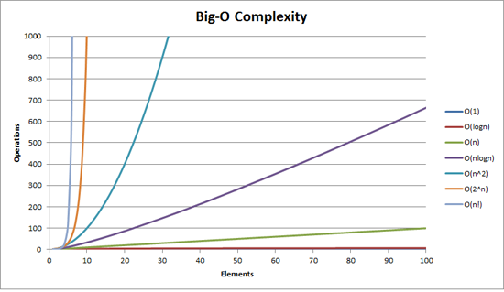
How Fast are your Functions?

Slide 27
Back to the wizard battle…
Notes:
2 wizard factions at war over the correct pronunciation of the word “gif”. They only have a limited amount of time in battle to cast spells so they need to learn to be efficient to win.
Things Smelling Like Fish. You cast it once for each enemy in the battle and they smell rotting fish for the next half an hour. One step for each enemy, so it is a O(N) spell. Scales linearly.
the spell of Pairwise Protection requires you to cast it on each pair of friends and enemies. If there are N enemies and M friends, you need to cast it M*N times. So the cost is O(M*N).
The spell of broken command chain is O(n!)

Slide 28

Easy Things
The curse of smelling like fish

Slide 29
Easy Things
The curse of smelling like fish
=
30 + 3n

Slide 30
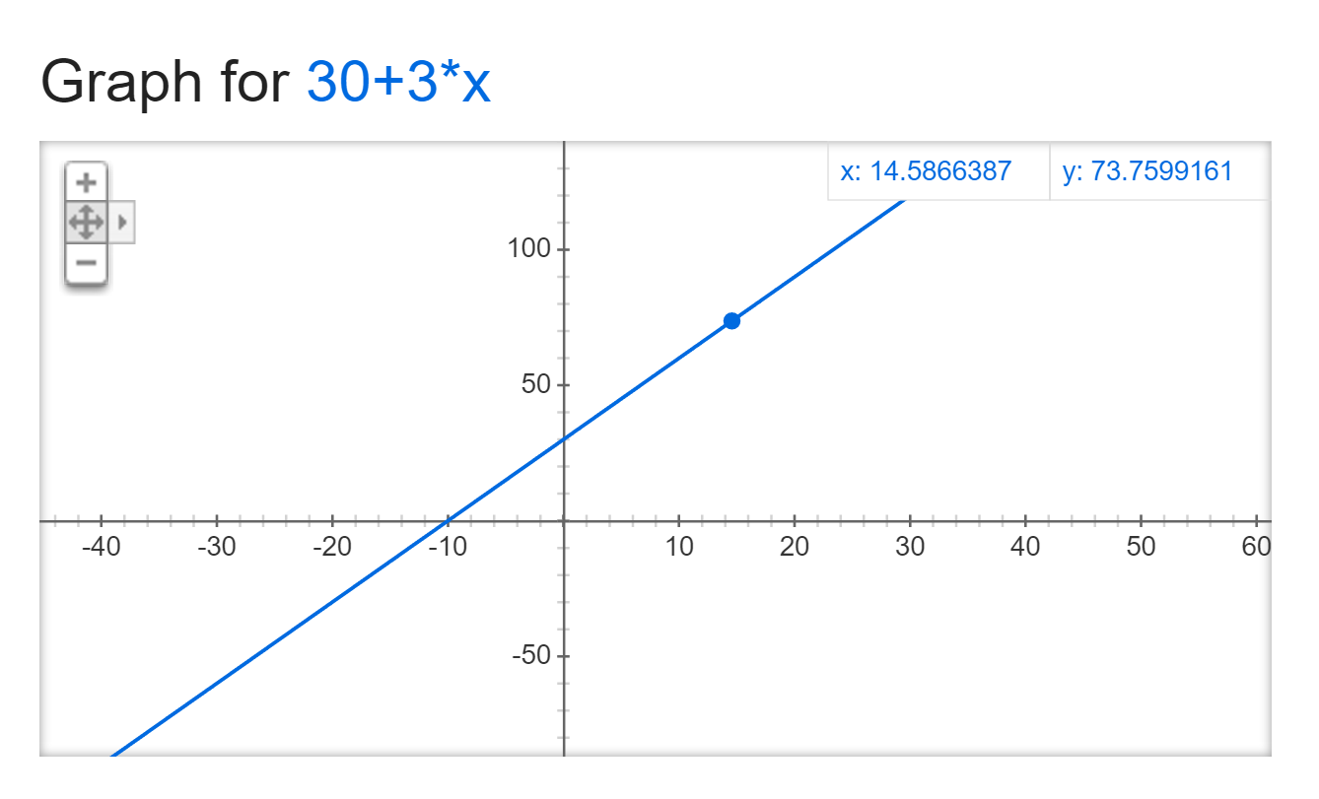
Easy Things
The curse of smelling like fish
=
30 + 3n

Slide 31
Easy Things
The curse of smelling like fish
=
O(30 + 3n)

Slide 32
Easy Things
The curse of smelling like fish
=
O(30 + 3n)
=
O(3n)

Slide 33
Easy Things
The curse of smelling like fish
=
O(30 + 3n)
=
O(3n) = O(n)

Slide 34
Easy Things

Slide 35
Also Easy Things
The spell of
Pairwise protection
2 * (# pairs of friend + enemy)
=

Slide 36
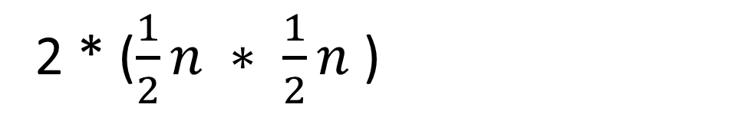
Also Easy Things
The spell of
Pairwise protection
2 * ($\frac{1}{2}n ∗ \frac{1}{2}n$)
=

Slide 37

Also Easy Things
The spell of
Pairwise protection
$2 ∗(\frac{1}{4}n2$ $)$
=

Slide 38
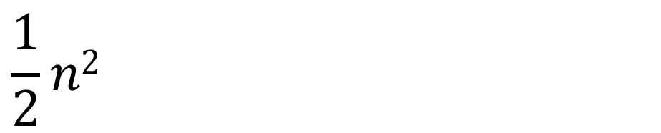
Also Easy Things
$$\frac{1}{2}n2$$
The spell of
Pairwise protection
=

Slide 39
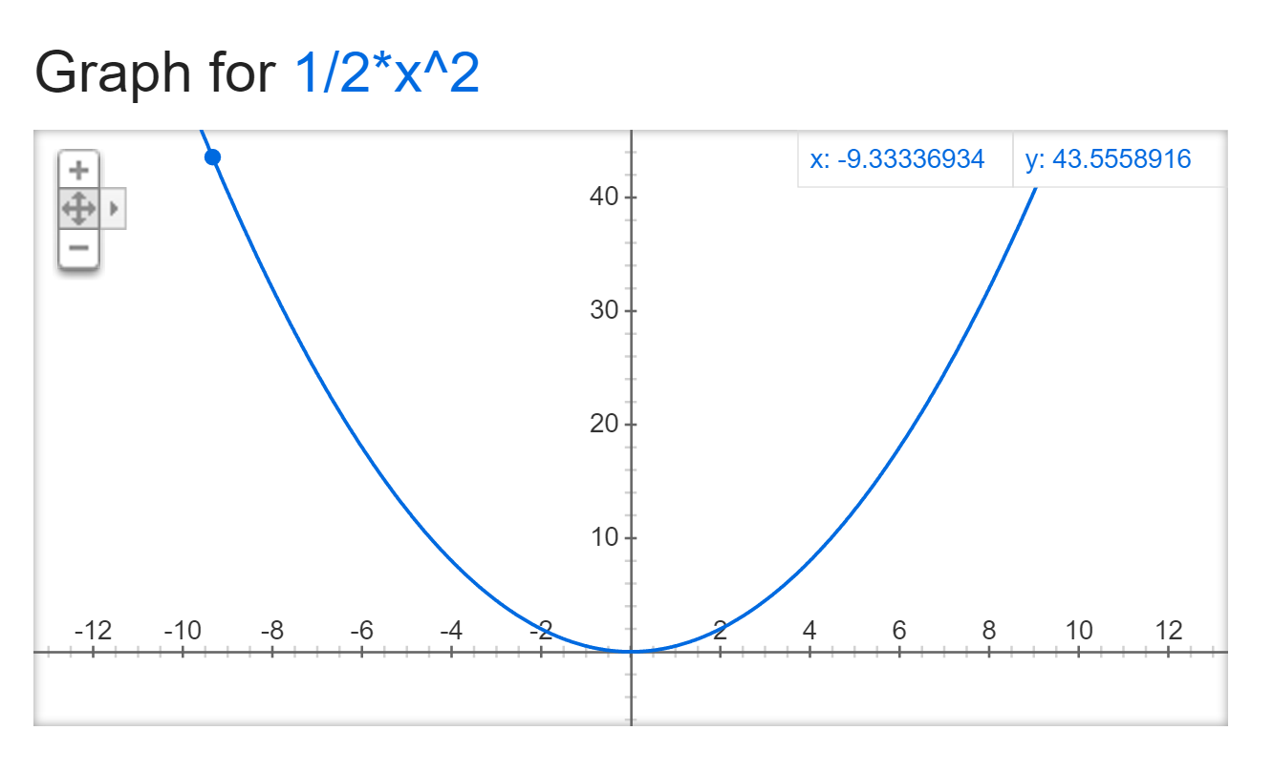
Also Easy Things
$$\frac{1}{2}n2$$
The spell of
Pairwise protection
=

Slide 40
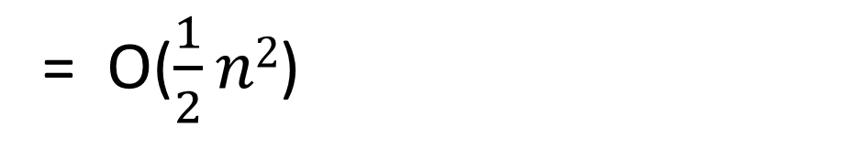
Also Easy Things
$$\frac{1}{2}n2$$
The spell of
Pairwise protection
=
= O($\frac{1}{2}n2$)

Slide 41
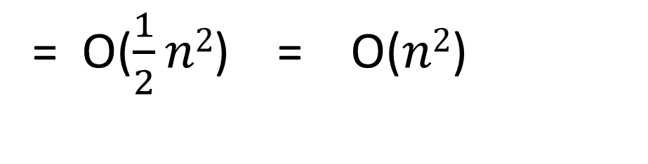
Also Easy Things
$$\frac{1}{2}n2$$
The spell of
Pairwise protection
=
= O($\frac{1}{2}n2$) = O($n2$)

Slide 42
Also Easy Things

Slide 43
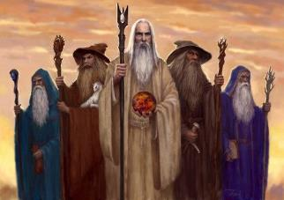
(Very) Hard Things
The jinx of broken
Command chains

Slide 44
(Very) Hard Things
The jinx of broken
Command chains
=
(# of different possible
chains of command)

Slide 45
(Very) Hard Things
The jinx of broken
Command chains
=
(# of different possible orders
for a list of n wizards)

Slide 46
(Very) Hard Things
The jinx of broken
Command chains
=
__ __ __ __ __ __ __ … __

Slide 47
(Very) Hard Things
The jinx of broken
Command chains
=
__ __ __ __ __ __ __ … __
n

Slide 48
(Very) Hard Things
The jinx of broken
Command chains
=
__ __ __ __ __ __ __ … __
n * n-1

Slide 49
(Very) Hard Things
The jinx of broken
Command chains
=
__ __ __ __ __ __ __ … __
n * n-1 * n-2 * n-3 * …

Slide 50
(Very) Hard Things
The jinx of broken
Command chains
=
O(n!)

Slide 51
(Very) Hard Things

Slide 52
The Hierarchy
NP - Hard
NP
NP Complete
P

Slide 53
The Hierarchy
NP - Hard
NP
NP Complete
Can find answers
in polynomial time
P

Slide 54
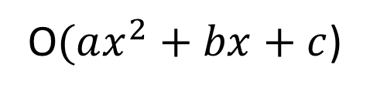
The Hierarchy
NP - Hard
NP
NP Complete
Can find answers
in polynomial time
P
O$(ax^{2}+bx+c$)

Slide 55
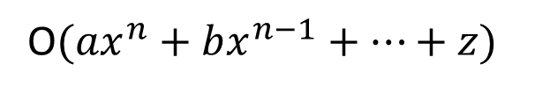
The Hierarchy
NP - Hard
NP
NP Complete
Can find answers
in polynomial time
P
O$({ax}^{n}+bx^{n−1}+…+z)$

Slide 56
The Hierarchy
NP - Hard
NP
NP Complete
Can check your answers
in polynomial time
P

Slide 57
The Hierarchy
NP - Hard
The “hardest” problems in NP
NP
NP Complete
P

Slide 58
The Hierarchy
NP - Hard
The “hardest” problems
in NP
If you can solve just one of these, you can solve all the problems in NP.
NP
NP Complete
P

Slide 59
The Hierarchy
Problems that are at least as hard as NP-complete
NP - Hard
NP
NP Complete
P

Slide 60
The Hierarchy
hard
NP - Hard
NP
NP Complete
P
easy

Slide 61
Hard Things
Problems that are interesting for humans (and computers) tend to be NP-Hard.
This is because usually, when there is a polynomial time algorithm for solving something, you can just use that solution to solve the game or problem very fast.
When something is NP-Hard, it’s on the opposite end of the spectrum from P.
This means we don’t know how to find that kind of fast solution, so instead we might just need to try out lots of different combinations of moves and strategies.

Slide 62
Hard Things
Problems that are interesting for humans (and computers) tend to be NP-Hard.
This is because usually, when there is a polynomial time algorithm for solving something, you can just use that solution to solve the game or problem very fast.
When something is NP-Hard, it’s on the opposite end of the spectrum from P.
This means we don’t know how to find that kind of fast solution, so instead we might just need to try out lots of different combinations of moves and strategies.

Slide 63
Hard Things
Problems that are interesting for humans (and computers) tend to be NP-Hard.
This is because usually, when there is a polynomial time algorithm for solving something, you can just use that solution to solve the game or problem very fast.
When something is NP-Hard, it’s on the opposite end of the spectrum from P.
This means we don’t know how to find that kind of fast solution, so instead we might just need to try out lots of different combinations of moves and strategies.

Slide 64
Hard Things
Problems that are interesting for humans (and computers) tend to be NP-Hard.
This is because usually, when there is a polynomial time algorithm for solving something, you can just use that solution to solve the game or problem very fast.
When something is NP-Hard, it’s on the opposite end of the spectrum from P.
This means we don’t know how to find that kind of fast solution, so instead we might just need to try out lots of different combinations of moves and strategies.

Slide 65
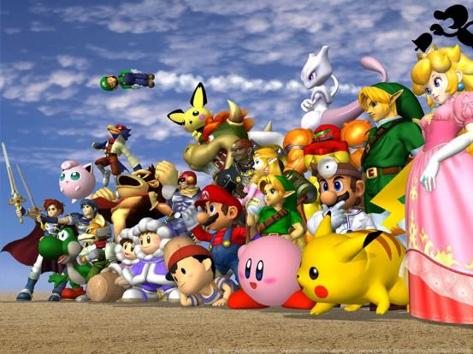
Hard Things

Slide 66
Hard Things
(The generalized versions of)
Mario Brothers
Metroid
Donkey Kong
Pokemon
Legend of Zelda
are all NP-hard !

Slide 67
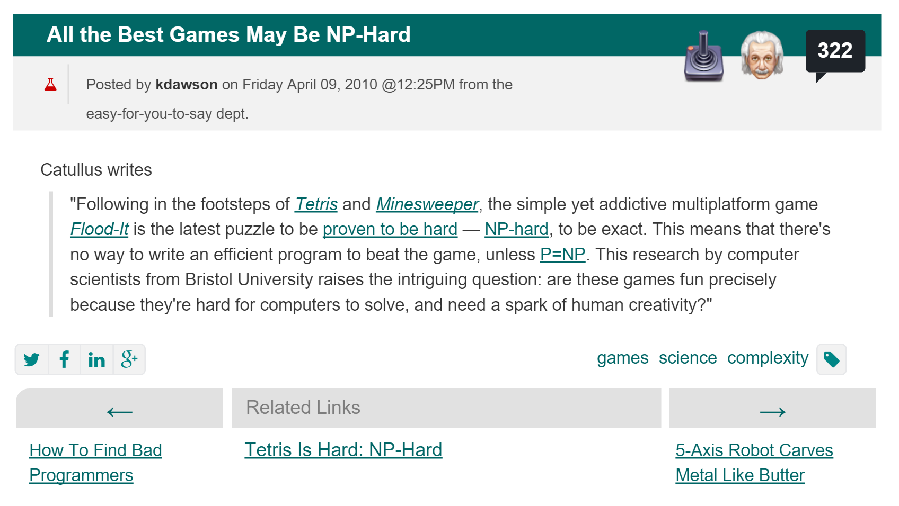
Hard Things

Slide 68

Hard Things

Slide 69
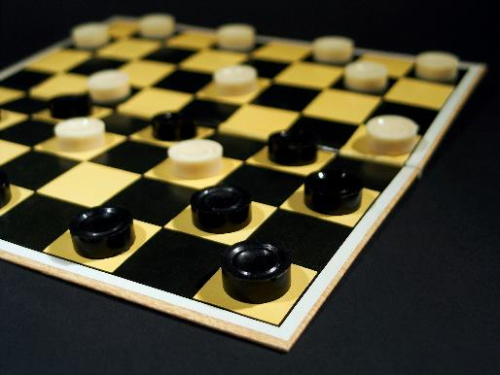
Hard Things

Slide 70
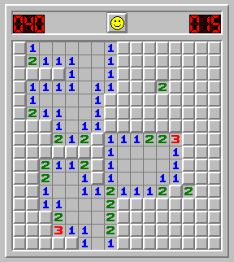
Hard Things

Slide 71
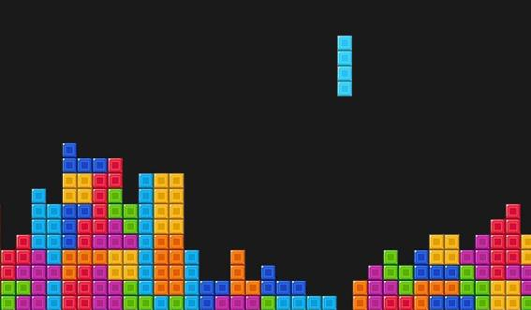
Hard Things

Slide 72

A Hard Problem
A travelling salesman wants to visit 100 different cities by driving, starting and ending his trip at home.

Slide 73
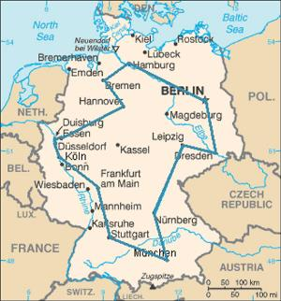
A Hard Problem
A travelling salesman wants to visit 100 different cities by driving, starting and ending his trip at home.

Slide 74
A Hard Problem
A travelling salesman wants to visit 100 different cities by driving, starting and ending his trip at home.
He has a limited supply of gasoline, so he can only drive a total of 10,000 kilometers.

Slide 75
A Hard Problem
A travelling salesman wants to visit 100 different cities by driving, starting and ending his trip at home.
He has a limited supply of gasoline, so he can only drive a total of 10,000 kilometers.
He wants to know if he can visit all of the cities without running out of gasoline.

Slide 76
The Hardest Question

Slide 77
The Hardest Question
The million dollar question (literally) is this:
Does P = NP ???
No
Yes
NP
NP
P = NP
P

Slide 78




P = NP?

Slide 79
P = NP?
NOPE!*

Slide 80
P = NP?
NOPE!*
*but we don’t actually know for sure

Slide 81
P = NP?
NP
P = NP
P
What would this mean for the world?

Slide 82
P = NP?
NP
P = NP
P
What would this mean for the world?
Hard problems would turn out to be easy
Break the world’s cryptosystems (RSA)
Find computer generated mathematical proofs
Better artificial intelligence
“If it did, we'd be living in a fundamentally different universe, and we'd probably have noticed by now.”

